Slide 1
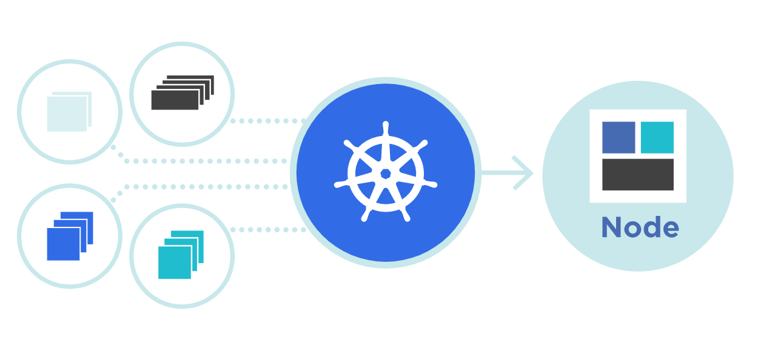




Volume
Theory + LAB + Documents ➔ All free
WATCH NOW
Notes:
Hello everyone. My name is Anish Rana and you are watching Kubernetes web series.

Slide 2
Agenda of this video.
Why we need Volume?
What is Volume?
Types of Volumes?
What is EmptyDir?
What is hostPath?
What is Static Volume?
What is Dynamic Volume?

Slide 3
01 NOW WE WILL TALK ABOUT
Why we need Volume?

Slide 4




mkdir /data
touch file1.txt file2.txt
^{Worker Node 1}
^{Worker Node 2}
^{VM: 192.168.1.31}
^{VM: 192.168.1.32}

Slide 5
mkdir /data
touch file1.txt file2.txt
^{Worker Node 1}
^{Worker Node 2}
^{VM: 192.168.1.31}
^{VM: 192.168.1.32}

Slide 6
mkdir /datatouch file1.txt file2.txt
^{Worker Node 1}
^{Worker Node 2}
^{VM: 192.168.1.31}
^{VM: 192.168.1.32}

Slide 7
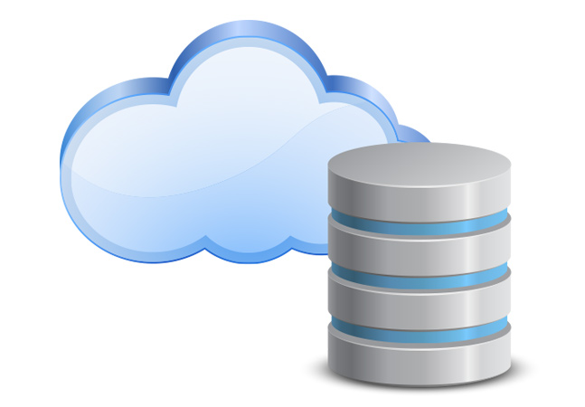
mkdir /datatouch file1.txt file2.txt
^{Worker Node 1}
^{Worker Node 2}
^{VM: 192.168.1.31}
^{VM: 192.168.1.32}

Slide 8
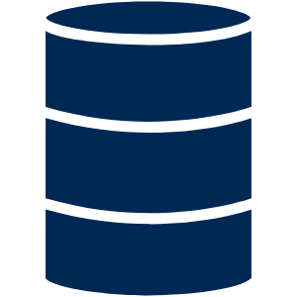
mkdir /datatouch file1.txt file2.txt
^{Worker Node 1}
^{Worker Node 2}
^{VM: 192.168.1.31}
^{VM: 192.168.1.32}

Slide 9
01 NOW WE WILL TALK ABOUT
What is Volume?

Slide 10
A Kubernetes volume is a directory containing, which can be accessed by containers in a Kubernetes pod.
volumes provide a plugin mechanism that connects to the containers with persistent data storage.

Slide 11
02 NOW WE WILL TALK ABOUT
Types of Volumes?

Slide 12
Volume
Ephemeral
Durable

Slide 13
Ephemeral
This is the category with the same volume lifetime as the Pod lifecycle but persists beyond container restart.
It is a fast volume solution but not durable, thus, should be used for temporary data or applications that do not require data persistency.
The volume types under this category are emptyDir, configMap, secret etc.
Durable
These are volume types that outlive the Pod lifecycle.
The lifetime is independent on the Pod lifecycle but persists across both container and Pod restarts.
Data is preserved in this category when Pod crashes or is deleted.
The volume types under this category are: hostPath,Dynamic,
Static, awsElasticBlockStore, azureDisk, gcePersistentDisk etc.

Slide 14
Volume
Ephemeral
Durable
123Vitara@1234
EmptyDir
ConfigMap
hostPath
Dynamic
Static
Secret
1. PV
1. StorageClass
2. PVC
2. PVC and PV

Slide 15
04 NOW WE WILL TALK ABOUT
What is EmptyDir?

Slide 16
An emptyDir volume is first created when a Pod is assigned to a node, and exists as long as that Pod is running on that node.
When a Pod is removed from a node for any reason, the data in the emptyDir is deleted permanently.
As the name says, the emptyDir volume is initially empty.
All containers in the Pod can read and write the same files in the emptyDir volume, though that volume can be mounted at the same or different paths in each container.
Kubernetes will create a random directory on node for the pod.

Slide 17
Initially Empty
Node
EmptyDir
RAM
SSD

Slide 18
apiVersion: v1
kind: Pod
metadata:
name: emptydir-pod1
namespace: core
spec:
containers:
- image: nginx
name: emptydir-container1

Slide 19
apiVersion: v1
kind: Pod
metadata:
name: emptydir-pod2
namespace: core
spec:
containers:
- image: nginx
name: emptydir-container2

Slide 20
apiVersion: v1
kind: Pod
metadata:
name: emptydir-pod2
namespace: core
spec:
volumes:
- name: vol1-emptydir
emptyDir:
sizeLimit: 500Mi
containers:
- image: nginx
name: emptydir-container2

Slide 21
apiVersion: v1
kind: Pod
metadata:
name: emptydir-pod2
namespace: core
spec:
volumes:
- name: vol1-emptydir
emptyDir:
sizeLimit: 500Mi
containers:
- image: nginx
name: emptydir-container2
volumeMounts:
- mountPath: /cache
name: vol1-emptydir

Slide 22
Initially Empty
Node
EmptyDir
RAM
SSD

Slide 23
Volume
Ephemeral
123Vitara@1234
EmptyDir
ConfigMap
Secret

Slide 24
Volume
Ephemeral
Durable
123Vitara@1234
EmptyDir
ConfigMap
hostPath
Dynamic
Static
Secret
1. PV
1. StorageClass
2. PVC
2. PVC and PV

Slide 25
05 NOW WE WILL TALK ABOUT
What is hostPath?

Slide 26
Initially Empty
Node
EmptyDir
RAM
Not Empty
SSD
hostPath

Slide 27
apiVersion: v1
kind: Pod
metadata:
name: pod1
namespace: core
spec:
containers:
- image: nginx
name: container1
Yaml file for hostPath

Slide 28
apiVersion: v1
kind: Pod
metadata:
name: hostpath-pod2
namespace: core
spec:
containers:
- image: nginx
name: hostpath-container2

Slide 29
Volume mount mode | Description
Directory | In this mode, a directory must exist in the specified path.
DirectoryOrCreate | If no directory found on this specified path, an empty directory will be created on demand. The permission will be set to 0755. The directory has the same group and ownership with kubelet.
File | In this mode, a file must exist in the specified path.
FileOrCreate | If no file found on this specified path, an empty file will be created on demand. Permission of the created file is set to 0644. The file has the same group and ownership with kubelet.
apiVersion: v1
kind: Pod
metadata:
name: hostpath-pod2
namespace: core
spec:
volumes:
- name: vol1-hostpath
hostPath:
path: /home/nfssharedata
type: DirectoryOrCreate
containers:
- image: nginx
name: hostpath-container2

Slide 30
apiVersion: v1
kind: Pod
metadata:
name: emptydir-pod2
namespace: core
spec:
volumes:
- name: vol1-hostpath
hostPath:
path: /home/nfssharedata
type: DirectoryOrCreate
containers:
- image: nginx
name: hostpath-container2
volumeMounts:
- mountPath: /vol1
name: vol1-hostpath

Slide 31
Volume
Ephemeral
Durable
123Vitara@1234
EmptyDir
ConfigMap
hostPath
Static
Dynamic
Secret
1. PV
1. StorageClass
2. PVC
2. PVC and PV

Slide 32
06 NOW WE WILL TALK ABOUT
What is Static Volume?

Slide 33
storage
NFS 100 GB
Kubernetes Cluster (Nodes)
Persistent Volume (PV)
SAN 500 TB
HHD
Persistent Volume Claim
(PVC)
D
Deployment
Persistent Volume
(PV)
PVC
Persistent Volume
(PV)
PVC
POD
SAN 400 TB
SSD

Slide 34


storage
namespace2
namespace1
NFS 100 GB
SAN 500 TB
HHD
SAN 400 TB
SSD

Slide 35
apiVersion: v1
kind: PersistentVolume
metadata:
name: nfs-pv
spec:
accessModes:
- ReadWriteMany
persistentVolumeReclaimPolicy: Recycle
capacity:
storage: 3Gi
volumeMode: Filesystem
nfs:
path: /home/nfsshare
server: 192.168.1.34
storageClassName: nfs
mountOptions:
- hard
- nfsvers=4.1
Access modes | Description
ReadWriteOnce(RWO)
ReadOnlyMany (ROX)
ReadWriteMany (RWX)
ReadWriteOncePod (RWOP)
- In this mode, volume can be mounted as read-write by a single node.
- It can allow multiple pods to access the volume when the pods are running on the same node.
In this mode, volume can be mounted as read-only by many nodes.
The volume can be mounted as read-write by many nodes.
- Volume can be mounted as read-write by a single Pod.
- Use ReadWriteOncePod access mode if you want to ensure that only one pod across whole cluster can read that PVC or write to it.
- This is only supported for CSI volumes and Kubernetes version 1.22+.

Slide 36
apiVersion: v1
kind: PersistentVolume
metadata:
name: nfs-pv
spec:
accessModes:
- ReadWriteMany
persistentVolumeReclaimPolicy: Recycle
capacity:
storage: 3Gi
volumeMode: Filesystem
nfs:
path: /home/nfsshare
server: 192.168.1.34
storageClassName: nfs
mountOptions:
- hard
- nfsvers=4.1
Current reclaim policies are 3 typs:
Retain -- After deleting the PVC, PV still exist, & Volume consider released.
Delete -- It removes both the PersistentVolume object from Kubernetes, as well as the associated storage asset in the external infrastructure.
Recycle -- basic scrub (rm -rf /thevolume/*)
Currently, only NFS and HostPath support recycling. AWS EBS, GCE PD, Azure Disk, and Cinder volumes support deletion.

Slide 37
apiVersion: v1
kind: PersistentVolume
metadata:
name: nfs-pv
spec:
accessModes:
- ReadWriteMany
persistentVolumeReclaimPolicy: Recycle
capacity:
storage: 3Gi
volumeMode: Filesystem
nfs:
path: /home/nfsshare
server: 192.168.1.34
storageClassName: nfs
mountOptions:
- hard
- nfsvers=4.1
Volume Mode
volumeMode is an optional API parameter.
Kubernetes supports two volumeModes: Filesystem and Block.
Filesystem is the default mode used when volumeMode parameter is not defined.
Filesystem is mounted into Pods into a directory. In block device if device is empty, Kubernetes creates a filesystem on the device before mounting it for the first time.
You can set the value of volumeMode to Block to use a volume as a raw block device.

Slide 38
apiVersion: v1
kind: PersistentVolume
metadata:
name: nfs-pv
spec:
accessModes:
- ReadWriteMany
persistentVolumeReclaimPolicy: Recycle
capacity:
storage: 3Gi
volumeMode: Filesystem
nfs:
path: /home/nfssharedata
server: 192.168.1.34
storageClassName: nfs
mountOptions:
- hard
- nfsvers=4.1
Types of Persistent Volumes
PersistentVolume types are implemented as plugins. Kubernetes currently supports the following plugins:
cephfs - CephFS volume
csi - Container Storage Interface (CSI)
fc - Fibre Channel (FC) storage
hostPath - HostPath volume (for single node only)
iscsi - iSCSI (SCSI over IP) storage
local - local storage devices mounted on nodes.
nfs - Network File System (NFS) storage
rbd - Rados Block Device (RBD) volume.
In this example, we create type NFS PV and the helper program /sbin/mount.nfs is required to support the mounting of NFS filesystems.

Slide 39
apiVersion: v1
kind: PersistentVolume
metadata:
name: nfs-pv
spec:
accessModes:
- ReadWriteMany
persistentVolumeReclaimPolicy: Recycle
capacity:
storage: 3Gi
volumeMode: Filesystem
nfs:
path: /home/nfssharedata
server: 192.168.1.34
storageClassName: nfs
mountOptions:
- hard
- nfsvers=4.1
Class
A PV can have a class, which is specified by setting the storageClassName attribute to the name of a StorageClass.
A PV of a particular class can only be bound to PVCs requesting that class.
A PV with no storageClassName has no class and can only be bound to PVCs that request no particular class.
In the past, the annotation volume.beta.kubernetes.io/storage-class was used instead of the storageClassName attribute. This annotation is still working; however, it will become fully deprecated in a future Kubernetes release.

Slide 40
apiVersion: v1
kind: PersistentVolume
metadata:
name: nfs-pv
spec:
accessModes:
- ReadWriteMany
persistentVolumeReclaimPolicy: Recycle
capacity:
storage: 3Gi
volumeMode: Filesystem
nfs:
path: /home/nfssharedata
server: 192.168.1.34
storageClassName: nfs
mountOptions:
- hard
- nfsvers=4.1
apiVersion: v1 kind: PersistentVolumeClaim metadata: name: task-pv-claim spec: storageClassName: nfs accessModes: - ReadWriteMany resources: requests: storage: 3Gi

Slide 41
apiVersion: v1
kind: PersistentVolume
metadata:
name: nfs-pv
spec:
accessModes:
- ReadWriteMany
persistentVolumeReclaimPolicy: Recycle
capacity:
storage: 3Gi
volumeMode: Filesystem
nfs:
path: /home/nfssharedata
server: 192.168.1.34
storageClassName: nfs
mountOptions:
- hard
- nfsvers=4.1
apiVersion: v1 kind: PersistentVolumeClaim metadata: name: task-pv-claim spec: storageClassName: nfs accessModes: - ReadWriteMany resources: requests: storage: 3Gi
apiVersion: v1 kind: Pod metadata: name: mypod spec: volumes: - name: mypd persistentVolumeClaim: claimName: task-pv-claim containers: - name: myfrontend image: nginx volumeMounts: - mountPath: "/var/www/html" name: mypd

Slide 42
apiVersion: v1
kind: PersistentVolume
metadata:
name: nfs-pv
spec:
accessModes:
- ReadWriteMany
persistentVolumeReclaimPolicy: Recycle
capacity:
storage: 3Gi
volumeMode: Filesystem
nfs:
path: /home/nfssharedata
server: 192.168.1.34
storageClassName: nfs
mountOptions:
- hard
- nfsvers=4.1
apiVersion: v1 kind: PersistentVolumeClaim metadata: name: task-pv-claim spec: storageClassName: nfs accessModes: - ReadWriteMany resources: requests: storage: 3Gi
apiVersion: v1 kind: Pod metadata: name: mypod spec: volumes: - name: mypd persistentVolumeClaim: claimName: task-pv-claim containers: - name: myfrontend image: nginx volumeMounts: - mountPath: "/var/www/html" name: mypd

Slide 43
apiVersion: v1
kind: PersistentVolume
metadata:
name: nfs-pv
spec:
accessModes:
- ReadWriteMany
persistentVolumeReclaimPolicy: Recycle
capacity:
storage: 3Gi
volumeMode: Filesystem
nfs:
path: /home/nfssharedata
server: 192.168.1.34
storageClassName: nfs
mountOptions:
- hard
- nfsvers=4.1
apiVersion: v1 kind: PersistentVolumeClaim metadata: name: task-pv-claim spec: storageClassName: nfs accessModes: - ReadWriteMany resources: requests: storage: 3Gi
apiVersion: v1 kind: Pod metadata: name: mypod spec: volumes: - name: mypd persistentVolumeClaim: claimName: task-pv-claim containers: - name: myfrontend image: nginx volumeMounts: - mountPath: "/var/www/html" name: mypd

Slide 44
apiVersion: v1
kind: PersistentVolume
metadata:
name: nfs-pv
spec:
accessModes:
- ReadWriteMany
persistentVolumeReclaimPolicy: Recycle
capacity:
storage: 3Gi
volumeMode: Filesystem
nfs:
path: /home/nfssharedata
server: 192.168.1.34
storageClassName: nfs
mountOptions:
- hard
- nfsvers=4.1
apiVersion: v1 kind: PersistentVolumeClaim metadata: name: task-pv-claim spec: storageClassName: nfs accessModes: - ReadWriteMany resources: requests: storage: 3Gi
apiVersion: v1 kind: Pod metadata: name: mypod spec: volumes: - name: mypd persistentVolumeClaim: claimName: task-pv-claim containers: - name: myfrontend image: nginx volumeMounts: - mountPath: "/var/www/html" name: mypd
A new VM installed
192.168.1.34
CenOS 9 OS
NFS installed
Export:
/home/nfssharedata
Kubernetes Cluster

Slide 45
How to install NFS server
ping 192.168.1.31
mkdir /home/nfsshare
dnf -y install nfs-utils
vi /etc/idmapd.conf
Domain = example.com
vi /etc/exports
/home/nfsshare 192.168.1.0/24(rw,no_root_squash)
exportfs -rv
systemctl enable --now rpcbind nfs-server
iptables -F
export -a
cd /home/nfsshare/
ls -ltr
touch file.txt
systemctl enable --now rpcbind nfs-server
firewall-cmd --add-service=nfs
firewall-cmd --runtime-to-permanent
On master and workernodes
yum install -y nfs-utils

Slide 46
cat <<EOF>> nfs-pv-pvc-pod.yaml
apiVersion: v1
kind: PersistentVolume
metadata:
name: nfs-pv
spec:
accessModes:
- ReadWriteMany
persistentVolumeReclaimPolicy: Recycle
capacity:
storage: 3Gi
volumeMode: Filesystem
nfs:
path: /home/nfsshare
server: 192.168.1.34
storageClassName: nfs
mountOptions:
- hard
- nfsvers=4.1
---
apiVersion: v1
kind: PersistentVolumeClaim
metadata:
name: task-pv-claim
spec:
storageClassName: nfs
accessModes:
- ReadWriteMany
resources:
requests:
storage: 3Gi
---
apiVersion: v1
kind: Pod
metadata:
name: mypod
spec:
volumes:
- name: mypd
persistentVolumeClaim:
claimName: task-pv-claim
containers:
- name: myfrontend
image: nginx
volumeMounts:
- mountPath: "/var/www/html"
name: mypd
EOF
apiVersion: v1
kind: PersistentVolume
metadata:
name: nfs-pv
spec:
accessModes:
- ReadWriteMany
persistentVolumeReclaimPolicy: Recycle
capacity:
storage: 3Gi
volumeMode: Filesystem
nfs:
path: /home/nfssharedata
server: 192.168.1.34
storageClassName: nfs
mountOptions:
- hard
- nfsvers=4.1
apiVersion: v1 kind: PersistentVolumeClaim metadata: name: task-pv-claim spec: storageClassName: nfs accessModes: - ReadWriteMany resources: requests: storage: 3Gi
apiVersion: v1 kind: Pod metadata: name: mypod spec: volumes: - name: mypd persistentVolumeClaim: claimName: task-pv-claim containers: - name: myfrontend image: nginx volumeMounts: - mountPath: "/var/www/html" name: mypd
kubectl apply -f nfs-pv-pvc-pod.yaml

Slide 47

[root@master1 pv]# kubectl get pods
NAME READY STATUS RESTARTS AGE
mypod 1/1 Running 0 108m
[root@master1 pv]# kubectl get pv
NAME CAPACITY ACCESS MODES RECLAIM POLICY STATUS CLAIM STORAGECLASS REASON AGE
nfs-pv 3Gi RWX Recycle Bound default/task-pv-claim nfs 109m
[root@master1 pv]# kubectl describe pv/nfs-pv
Name: nfs-pv
Labels: <none>
Annotations: pv.kubernetes.io/bound-by-controller: yes
Finalizers: [kubernetes.io/pv-protection]
StorageClass: nfs
Status: Bound
Claim: default/task-pv-claim
Reclaim Policy: Recycle
Access Modes: RWX
VolumeMode: Filesystem
Capacity: 3Gi
Node Affinity: <none>
Message:
Source:
Type: NFS (an NFS mount that lasts the lifetime of a pod)
Server: 192.168.1.34
Path: /home/nfsshare
ReadOnly: false
Events: <none>
Retain -- After deleting the PVC, PV still exist, & Volume consider released.
Delete -- Removes PersistentVolume & associated storage.
Recycle -- (rm -rf /thevolume/*)
Available: The PV is free and not yet claimed or bounded.
Bound: The PV has been claimed or bounded.
Released: The bounded PVC has been deleted, and the PV is free from its previous bounded state.
Failed: The PV has failed its automatic reclamation.

Slide 48
[root@master1 pv]#
NAME STATUS VOLUME CAPACITY ACCESS MODES STORAGECLASS AGE
task-pv-claim Bound nfs-pv 3Gi RWX nfs 112m
[root@master1 pv]#
Name: task-pv-claim
Namespace: default
StorageClass: nfs
Status: Bound
Volume: nfs-pv
Labels: <none>
Annotations: pv.kubernetes.io/bind-completed: yes
pv.kubernetes.io/bound-by-controller: yes
Finalizers: [kubernetes.io/pvc-protection]
Capacity: 3Gi
Access Modes: RWX
VolumeMode: Filesystem
Used By: mypod
Events: <none>
kubectl get pvc
kubectl describe pvc/task-pv-claim
Bound: The PVC is bound to a PV.
Pending: The PVC can not bind to a PV.
- Could be requested higher storage request than the PV capacity?
- PV accessMode is not matched with PVC?

Slide 49
[root@master1 pv]#
Name: mypod
Status: Running
IP: 172.16.133.178
IPs:
IP: 172.16.133.178
Containers:
myfrontend:
Container ID: containerd://1e159f06c7b2e23424f0ef3687c6800609ec1642e1c1f0d809d79d9837a6412e
Image: nginx
Image ID: docker.io/library/nginx@sha256:63b44e8ddb83d5dd8020327c1f40436e37a6fffd3ef2498a6204df23be6e7e94
Port: <none>
Host Port: <none>
State: Running
Started: Mon, 17 Apr 2023 09:16:18 +0530
Ready: True
Restart Count: 0
Environment: <none>
Mounts:
/var/run/secrets/kubernetes.io/serviceaccount from kube-api-access-f7lww (ro)
/var/www/html from mypd (rw)
Volumes:
mypd:
Type: PersistentVolumeClaim (a reference to a PersistentVolumeClaim in the same namespace)
ClaimName: task-pv-claim
ReadOnly: false
kubectl describe pod/mypod

Slide 50
[root@master1 pv]#
root@mypod:/#
root@mypod:/var/www/html#
total 0
-rw-r--r-- 1 root root 0 Apr 16 14:29 file.txt
root@mypod:/var/www/html#
[root@server1 ~]#
[root@server1 nfsshare]#
total 4
-rw-r--r--. 1 root root 0 Apr 18 20:51 file.txt
-rw-r--r--. 1 root root 34 Apr 18 20:52 file2.txt
[root@server1 nfsshare]#
[root@server1 nfsshare]#
File updated inside the container
File updated from NFS server
root@mypod:/var/www/html#
File updated inside the container
File updated from NFS server
kubectl exec -it mypod -- /bin/bash
cd /var/www/html/
ls -ltr
echo "File updated inside the container" > file2.txt
cd /home/nfsshare/
ls -ltr
echo "File updated from NFS server" >> file2.txt
cat file2.txt
cat file2.txt

Slide 51
Volume
Ephemeral
Durable
123Vitara@1234
EmptyDir
ConfigMap
hostPath
Static
Dynamic
Secret
1. PV
1. StorageClass
2. PVC
2. PVC and PV

Slide 52
07 NOW WE WILL TALK ABOUT
What is Dynamic Volume?

Slide 53
storage
NFS 100 GB
Kubernetes Cluster (Nodes)
Storage NFS
PV
D
Deployment
PV
PVC
Storage HHD
SAN 500 TB
HHD
PVC
POD
POD
POD
Storage SSD
PV
PVC
SAN 400 TB
SSD

Slide 54
08 NOW WE WILL TALK ABOUT
What is Dynamic Volume?

Slide 55
Dynamic storage provisioning is the process of automatically allocating storage to containers in the Kubernetes cluster.
Its being done automatically by the Kubernetes control plane when it detects that a container needs storage.
The control plane will select a storage class based on the container’s configuration, then automatically creates a new persistent volume (PV) using that storage class.
After that, as in static provisioning, the PV is attached to the container, and the container can use the storage via a PVC.

Slide 56
09 NOW WE WILL TALK ABOUT
What is StorageClass?

Slide 57
StorageClass objects were introduced in Kubernetes 1.5.
A storage class in Kubernetes defines different storage types, which allows the user to request a specific type of storage for their workloads.
With the help Storage Classes, we can control which type of storage is required for specific workloads.

Slide 58
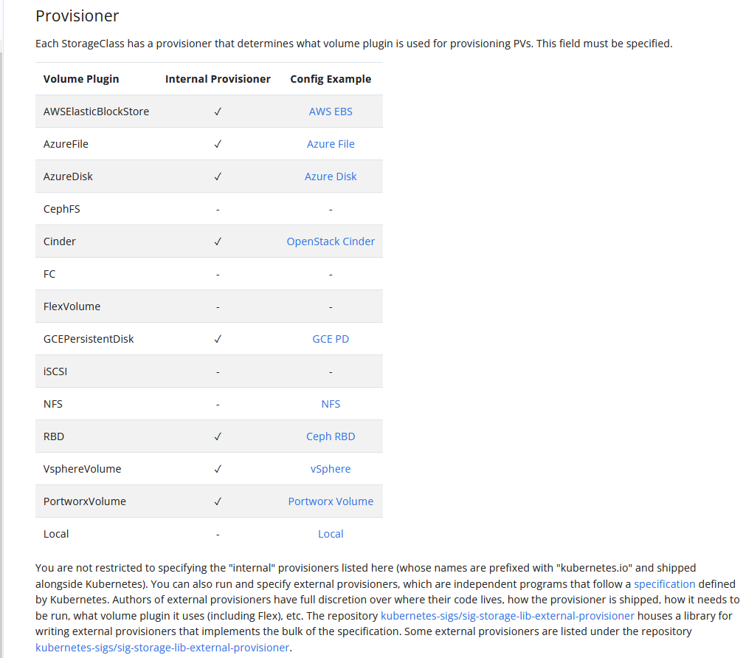
apiVersion: storage.k8s.io/v1
kind: StorageClass
metadata:
name: nfs-client
provisioner: k8s-sigs.io/nfs # This name must match deployment's env PROVISIONER_NAME'
parameters:
archiveOnDelete: "false"

Slide 59
apiVersion: storage.k8s.io/v1
kind: StorageClass
metadata:
name: nfs-client
provisioner: k8s-sigs.io/nfs # This name must match deployment's env PROVISIONER_NAME'
parameters:
archiveOnDelete: "false"
Name | Description
onDelete | onDelete= Delete : Data will be removed from the storage server. onDelete= Retain : Data will be not removed.
archiveOnDelete | If this parameter is set to false, then data will be removed. If onDelete exists, archiveOnDelete will be ignored.
pathPattern | Specifies a template for creating a directory path via PVC metadata's such as labels, annotations, name or namespace.

Slide 60
apiVersion: storage.k8s.io/v1
kind: StorageClass
metadata:
name: nfs-client
provisioner: k8s-sigs.io/nfs
parameters:
archiveOnDelete: "false"
onDelete= Delete : Data will be removed from the storage server.
onDelete= Retain : Data will be not removed.
onDelete
archiveOnDelete
If this parameter is set to false, then data will be removed.
If onDelete exists, archiveOnDelete will be ignored.
Specifies a template for creating a directory path via PVC metadata's such as labels, annotations, name or namespace.
pathPattern

Slide 62
10 NOW WE WILL TALK ABOUT
ConfigMap

Slide 63
What is configMap?
How to create configMap?
From Yaml file.
From command line.
How to insert the variables into Container?
Environment variables.
From files or directory.
From yaml file.
env
envFrom
From command line.
volume
Yaml file.
Notes:
Agenda of this video are :

Slide 64
11 NOW WE WILL TALK ABOUT
What is ConfigMap?

Slide 65
A ConfigMap is an API object used to store non-confidential data in key-value pairs.
ConfigMap does not provide secrecy or encryption.
Kubernetes provides these values to your containers.
Pods can consume ConfigMaps as environment variables, command-line arguments, or as configuration files in a volume.
A ConfigMap allows you to decouple environment-specific configuration from your container images, so that your applications are easily portable.
A ConfigMap is not designed to hold large chunks of data. The data stored in a ConfigMap cannot exceed 1 MiB.

Slide 66
How to create configMap?
Create configMap through Yaml file.
Create a configMap from command line.

Slide 67
ConfigMap yaml
kind: ConfigMap apiVersion: v1 metadata: name: example-configmap1 namespace: core data: NGINX_PORT: "8080" language: “English" environments: production, development, test

Slide 68
Create configMap through Yaml file.
Create a configMap from command line.

Slide 69
kubectl create configmap command-configmap
--from-literal=NGINX_PORT=8080
--from-literal=language=english
--from-literal=environments=production,development,test
kind: ConfigMap apiVersion: v1 metadata: name: command-configmap data: NGINX_PORT: "8080" language: "english" environments: production, development, test
[root@master1 volume]# kubectl describe configmaps command-configmap
Name: command-configmap
Namespace: default
Labels: <none>
Annotations: <none>
Data
====
NGINX_PORT:
----
8080
environments:
----
production,development,test
language:
----
english
BinaryData
====
Events: <none>

Slide 70
12 NOW WE WILL TALK ABOUT
How to insert the variables into Container?
Environment variables.
volume

Slide 71
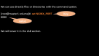
Environment variables.
From files or directory.
From yaml file.
env
envFrom
From command line.
volume
Yaml file.

Slide 72
We can use directly files or directories with the command option.
[root@master1 volume]# cat NGINX_PORT
8080
We will cover it in the LAB section.
Key
value

Slide 73

Environment variables.
From files or directory.
From yaml file.
env
envFrom
From command line.
volume
Yaml file.

Slide 74
apiVersion: apps/v1
kind: Deployment
metadata:
name: env-deploy
spec:
selector:
matchLabels:
app: env-deploy
template:
metadata:
labels:
app: env-deploy
spec:
containers:
- name: env-cont
image: nginx
From yaml file with env

Slide 75
apiVersion: apps/v1
kind: Deployment
metadata:
name: env-deploy
spec:
selector:
matchLabels:
app: env-deploy
template:
metadata:
labels:
app: env-deploy
spec:
containers:
- name: env-cont
image: nginx
env:
- name: NGINX-PORT
valueFrom:
configMapKeyRef:
name: example-configmap
key: NGINX_PORT
- name: WEB-APP-LANG
valueFrom:
configMapKeyRef:
name: example-configmap
key: language

Slide 76
spec:
containers:
- name: env-cont
image: nginx
env:
- name: NGINX-PORT
valueFrom:
configMapKeyRef:
name: example-configmap
key: NGINX_PORT
- name: WEB-APP-LANG
valueFrom:
configMapKeyRef:
name: example-configmap
key: language
env:
- name: key1
value: “value1"
- name: key2
value: “value2”
kind: ConfigMap apiVersion: v1 metadata: name: example-configmap data: NGINX_PORT: "8080" language: "english" environments: production, development, test

Slide 77
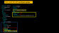
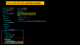
Environment variables.
From files or directory.
From yaml file.
env
envFrom
From command line.
volume
Yaml file.

Slide 78
From yaml file with envFrom syntax
apiVersion: apps/v1 kind: Deployment metadata: name: env-deploy spec: replicas: 5 selector: matchLabels: app: env-deploy template: metadata: labels: app: env-deploy spec: containers: - name: env-cont image: nginx envFrom: - configMapRef: name: example-configmap
kind: ConfigMap apiVersion: v1 metadata: name: example-configmap data: NGINX_PORT: "8080" language: "english" environments: production, development, test

Slide 79
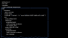
Environment variables.
From files or directory.
From yaml file.
env
envFrom
From command line.
volume
Yaml file.

Slide 80
apiVersion: v1
kind: Pod
metadata:
name: configmap-example-pod
spec:
containers:
- name: env-cont
image: nginx
command: [ "/bin/sh", "-c", "echo $(NGINX-PORT) $(WEB-APP-LANG)" ]
env:
- name: NGINX-PORT
valueFrom:
configMapKeyRef:
name: example-configmap
key: NGINX_PORT
- name: WEB-APP-LANG
valueFrom:
configMapKeyRef:
name: example-configmap
key: language

Slide 81
spec:
containers:
- name: env-cont
image: nginx
command: [ "/bin/sh", "-c", "echo $(NGINX-PORT) $(WEB-APP-LANG)" ]
env:
- name: NGINX-PORT
valueFrom:
configMapKeyRef:
name: example-configmap
key: NGINX_PORT
- name: WEB-APP-LANG
valueFrom:
configMapKeyRef:
name: example-configmap
key: language
kind: ConfigMap apiVersion: v1 metadata: name: example-configmap data: NGINX_PORT: "8080" language: "english" environments: production, development, test

Slide 82
[root@master1 volume]# kubectl create -f newpod.yaml
pod/configmap-example-pod created
[root@master1 volume]# kubectl get pods
NAME READY STATUS RESTARTS AGE
configmap-example-pod 0/1 Completed 1 (3s ago) 6s
[root@master1 volume]# kubectl logs configmap-example-pod
8080 english
command: [ "/bin/sh", "-c", "echo $(NGINX-PORT) $(WEB-APP-LANG)" ]

Slide 83
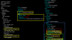
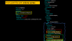
Environment variables.
From files or directory.
From yaml file.
env
envFrom
From command line.
volume
Yaml file.

Slide 84
apiVersion: apps/v1 kind: Deployment metadata: name: volume-deploy namespace: core spec: replicas: 5 selector: matchLabels: app: volume-deploy template: metadata: labels: app: volume-deploy spec: containers: - name: vol-cont image: nginx volumeMounts: - name: config-volume mountPath: /etc/config volumes: - name: config-volume configMap: name: example-configmap1
apiVersion: apps/v1
kind: Deployment
metadata:
name: env-deploy
spec:
selector:
matchLabels:
app: env-deploy
template:
metadata:
labels:
app: env-deploy
spec:
containers:
- name: env-cont
image: nginx
env:
- name: NGINX-PORT
valueFrom:
configMapKeyRef:
name: example-configmap
key: NGINX_PORT
- name: WEB-APP-LANG
valueFrom:
configMapKeyRef:
name: example-configmap
key: language
kind: ConfigMap apiVersion: v1 metadata: name: example-configmap data: NGINX_PORT: "8080" language: "english" environments: production, development, test

Slide 85
Immutable ConfigMaps
kind: ConfigMap
apiVersion: v1
metadata:
name: example-configmap1
immutable: true
data:
NGINX_PORT: "8080"
language: "english"
datascie: test

Slide 86
13 NOW WE WILL TALK ABOUT
configMap LAB + Exam preparation

Slide 87
14 NOW WE WILL TALK ABOUT
Secret

Slide 88
Topics to be covered in Secret
What is secret?
What is the difference between configMap and Secret?
How to create Secret?
From Yaml
From command line.
How to insert Secret variables in POD/ Deployment?
LAB:
01 secret plain text.md
02 secret with encrypted variables.md
03 secret with immutable.md
04 Secret with command line.md

Slide 89


Stores in RAM
RAM
Size 1 MB
workernode

Slide 90
In Kubernetes, Secrets are similar to ConfigMaps but are specifically intended to hold confidential data.
Secrets can be created independently of the Pods that use them, thus, there is less risk of the Secret (and its data) being exposed during the workflow of creating, viewing, and editing Pods.
Using a Secret means that you don't need to include confidential data in your application code.
Secrets gives you more flexibility in a Pod Life cycle definition and encrypt the sensitive data such as a password, a token, PKI or certificate, or a key.
API server stores secrets as unencrypted (plain text) in etcd database.
Like configMap, secrets are namespaced objects, size limit is also 1 MB & data is stored in tmpfs (RAM) in workernode.

Slide 91
15 NOW WE WILL TALK ABOUT
How to create Secret

Slide 92
Create secrets through Yaml file.
Create a secrets from command line.

Slide 93
apiVersion: v1
kind: Secret
metadata:
name: prod-db-secret
type: Opaque
stringData:
username: database
password: Mysql123
Built-in Type Usage
Opaque arbitrary user-defined data
kubernetes.io/service-account-token ServiceAccount token
kubernetes.io/dockercfg serialized ~/.dockercfg file
kubernetes.io/dockerconfigjson serialized ~/.docker/config.json file
kubernetes.io/basic-auth credentials for basic authentication
kubernetes.io/ssh-auth credentials for SSH authentication
kubernetes.io/tls data for a TLS client or server
bootstrap.kubernetes.io/token bootstrap token data

Slide 94
apiVersion: v1
kind: Secret
metadata:
name: newsecret
type: Opaque
data:
username: ZGF0YWJhc2U=
password: TXlzcWwxMjM=
echo -n '[value1]' | base64
echo -n database | base64 => ZGF0YWJhc2U=
echo -n Mysql123 | base64 => TXlzcWwxMjM=
immutable: true

Slide 95
Create secret through Yaml file.
Create a secret from command line.

Slide 96
kubectl create secret generic [secret-name] --from-file=[file1] --from-file=[file2]
kubectl create secret generic prod-db-secret ---from-file=./username.txt --from-file=./password.txt
kubectl create secret generic prod-db-secret -- --from-file=ssh-privatekey=/path/to/.ssh/id_rsa \
--from-file=ssh-publickey=/path/to/.ssh/id_rsa.pub
kubectl create secret generic prod-db-secret --from-literal=username=produser --from-literal=password=MystrongPass

Slide 97
16 NOW WE WILL TALK ABOUT
How to insert secret in a POD/Deployment?

Slide 98
apiVersion: v1
kind: Pod
metadata:
name: secret-volume-pod
spec:
containers:
- name: mypod
image: redis
volumeMounts:
- name: foo
mountPath: "/etc/foo"
readOnly: true
volumes:
- name: foo
secret:
secretName: prod-db-secret
optional: true
apiVersion: v1
kind: Secret
metadata:
name: prod-db-secret
type: Opaque
data:
username: database
password: ‘Mysql123’
apiVersion: v1
kind: Pod
metadata:
name: secret-env-pod
spec:
containers:
- name: secret-env-pod
image: redis
env:
- name: SECRET_USERNAME
valueFrom:
secretKeyRef:
name: prod-db-secret
key: username
- name: SECRET_PASSWORD
valueFrom:
secretKeyRef:
name: prod-db-secret
key: password

Slide 99
13 NOW WE WILL TALK ABOUT
Secret LAB + Exam preparation

